Slide 1

CORPORATE OVERVIEW
January 2024

Slide 2

DISCLAIMER
Forward-Looking Statements
This presentation contains forward-looking statements about SINTX Technologies, Inc. (the “Company”). These forward-looking statements are made pursuant to the safe harbor provisions of the Private Securities Litigation Reform Act of 1995. These forward-looking statements relate to the Company’s financial results, products, product candidates, the expected timing of the regulatory approval of our product candidates, regulatory processes and objectives, potential benefits of the Company’s product candidates, intellectual property and related matters, all of which involve known and unknown risks and uncertainties. Actual results may differ materially from the forward-looking statements discussed in this presentation.
Accordingly, the Company cautions investors not to place undue reliance on the forward-looking statements contained in, or made in connection with, this presentation. The forward-looking statements contained in this presentation are further qualified by the detailed discussion of risks and uncertainties set forth in the Company’s Annual Report on form 10-K filed with the Securities and Exchange Commission (SEC) on March 29, 2023, and in the Company’s other filings with the SEC which can be obtained on the Company’s website at www.sintx.com or on the SEC website at www.sec.gov. The forward-looking statements contained in this document represent the Company’s estimates and assumptions only as of the date of this presentation and the Company undertakes no duty or obligation to update or revise publicly any forward-looking statements contained in this presentation as a result of new information, future events or changes in the Company’s expectations.
Supporting documentation for all claims:
https://sintx.com/resources/references/

Slide 3
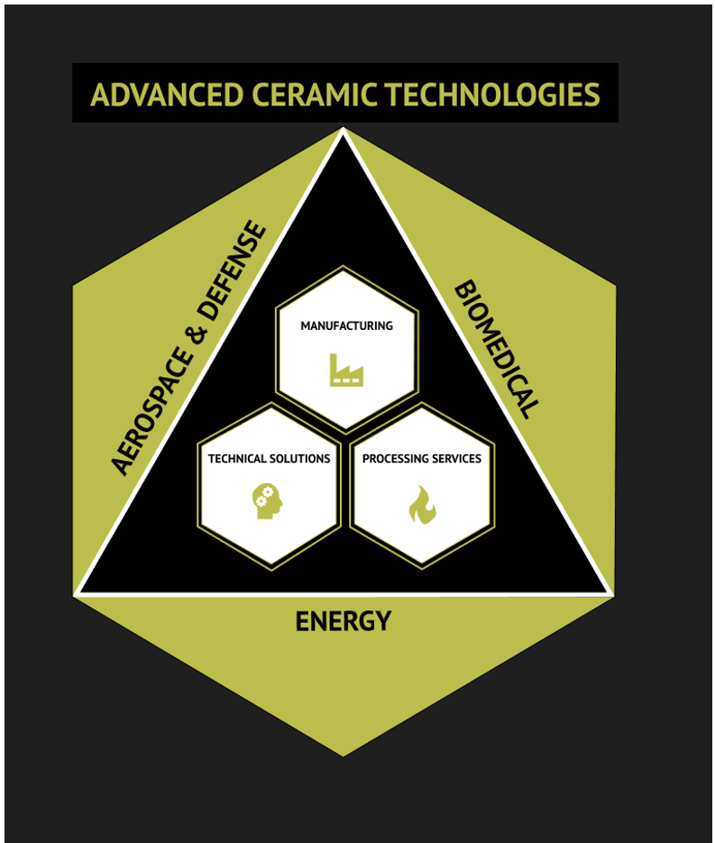
Our Active Businesses
Additive Manufacturing of Advanced Ceramics and Composites
Production of High-performance Silicon Nitride Biomedical and Aerospace Components
Development of Complex Thermal Barrier Coatings for Aerospace and Energy Applications

Slide 4
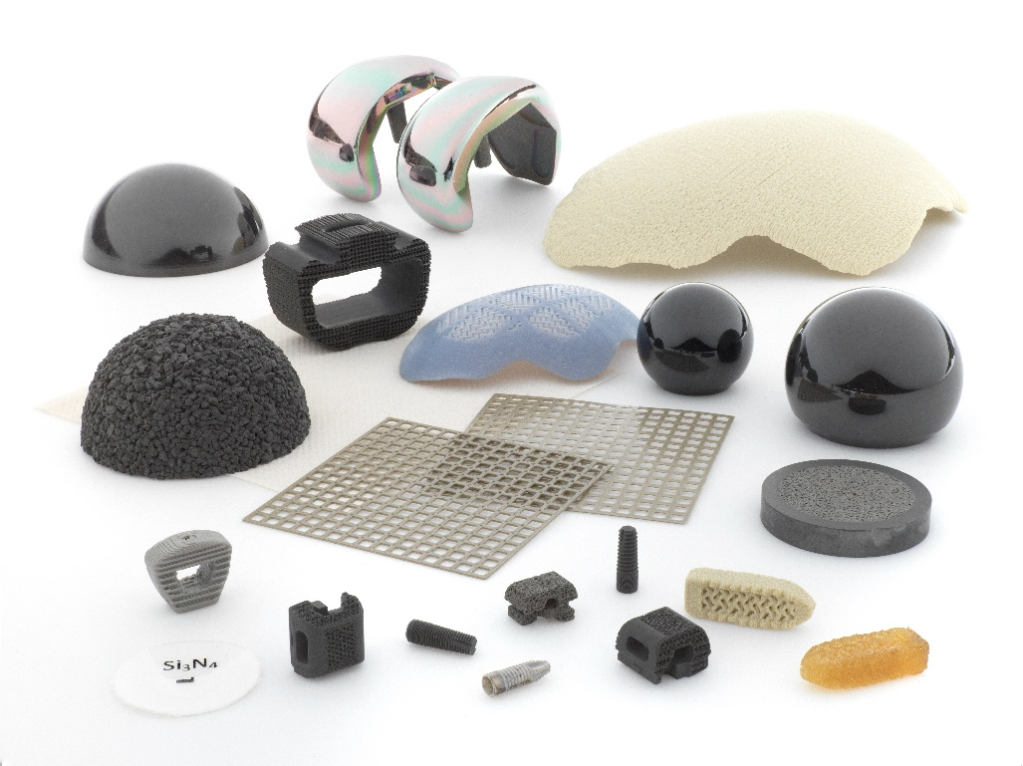
CORE STRENGTHS
Manufacturing Expertise
FDA and ANVISA registered facility
Quality certified to ISO 13485:2016 and AS9100D
Vertically integrated - rapid development of turnkey solutions for feedstocks, forming and firing cycles, and finished components
>40,000 spinal implants – safe and effective
AS9100D Certification held for production of aerospace components
ISO 9001:2015 Certification held for general GMP

Slide 5
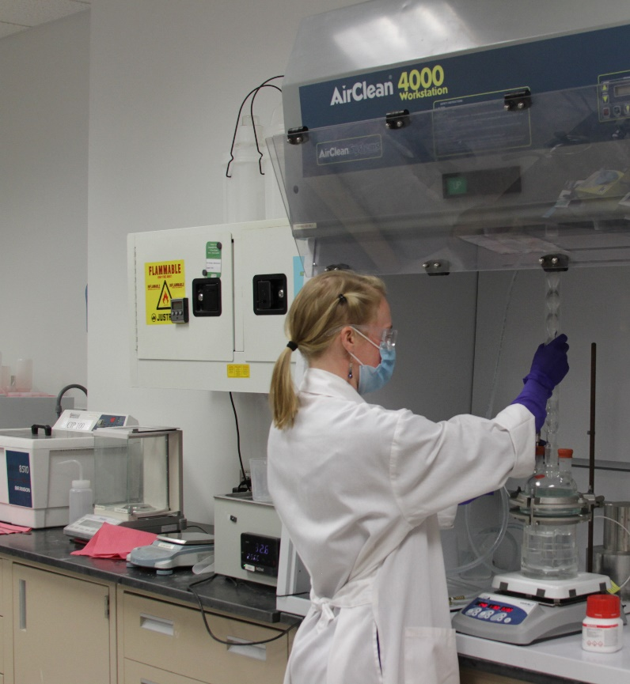
CORE STRENGTHS
Strong IP & Regulatory Portfolio
15 issued patents
144 patent applications in process
FDA Master Files
Scientific achievements
Over 140 peer-reviewed scientific publications
More than 100 technical and scientific presentations
Research independently corroborated
Over 160 SBIR/STTR awards to fund technology development in defense, energy, and biomedical

Slide 6
DIVERSIFIED CERAMICS TECHNOLOGY SOLUTIONS

Slide 7

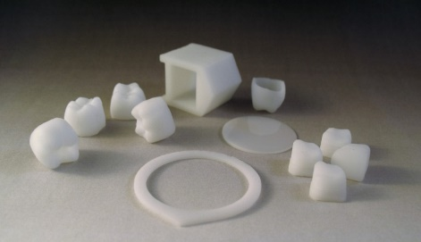

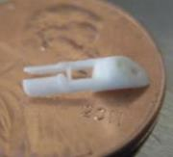
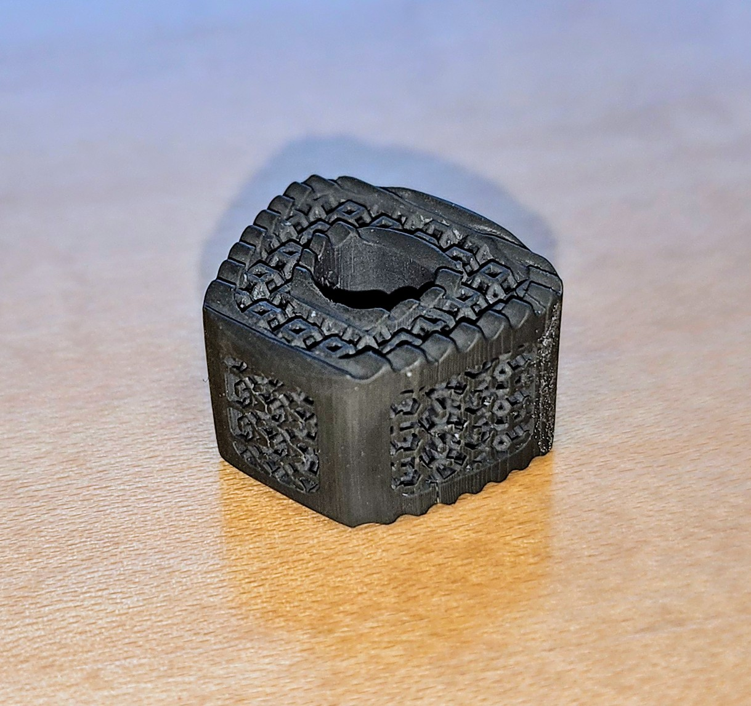
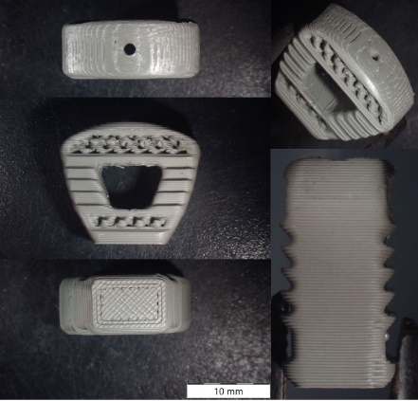
3D PRINTING TECHNOLOGIES
Dense Ceramics
A complete additive manufacturing workflow from resin development through sintering integrates 3D printing with unique SINTX materials to reduce development time and costs. Excellent results have been achieved in medical device components, heat exchangers for aerospace applications, ceramic cores for jet engine blades, and many other complex components that can reduce part count and enhance performance capabilities.
Ceramic-Polymer Composites
Use of our proprietary composite materials and our implant-grade 3D printer allows us to directly print complex features such as textures and interconnected porosity into biomedical devices. The composite materials contain silicon nitride as an active ingredient to improve device biocompatibility and bone healing while also reducing infection risk.

Slide 8
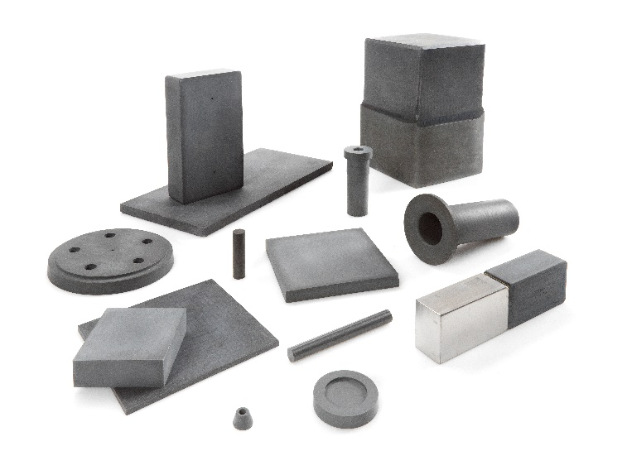




SILICON NITRIDE for AEROSPACE, ENERGY, etc.
Our STX-100 grade of silicon nitride combines mechanical, thermal, and electrical properties. Ideal for applications requiring extreme durability, thermal stability, exceptional strength, and resistance to wear.
ENERGY
AUTOMOTIVE &
AEROSPACE BRAKES
AEROSPACE MATERIALS
AUTOMOTIVE
CERAMICS
WELDING

Slide 9
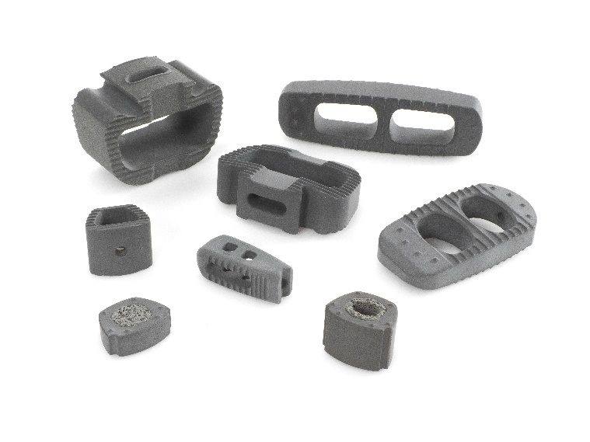




SILICON NITRIDE for BIOMEDICAL
Our FleX-SN medical-grade silicon nitride is ideal for biomedical implants. FleX-SN is biocompatible, bioactive, antimicrobial, and shows superb bone-affinity.
SPINE
CRANIOMAXILLOFACIAL
DENTAL IMPLANTS
FOOT & ANKLE
KNEE & HIP

Slide 10
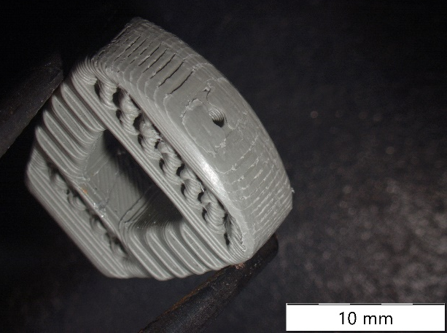

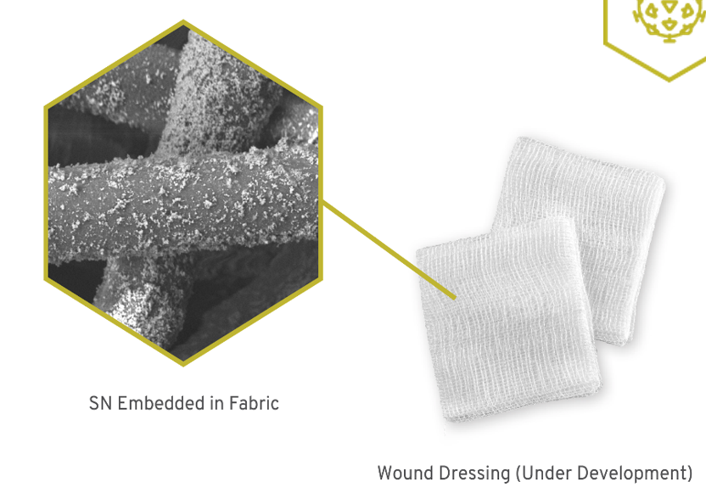
SN COMPOSITES
Composite materials combine advantages of different materials. SINTX manufactures composites of silicon nitride powder and PEEK or PEKK ready for 3D printing – both are polymer materials with stiffness similar to human bone.
FleX-SN AP Powder can be integrated into products and fabrics that inactivate bacteria, fungi, and viruses – including the SARS-CoV-2 virus.
3D Printed, SN-PEEK Cervical Interbody Spine Implant

Slide 11
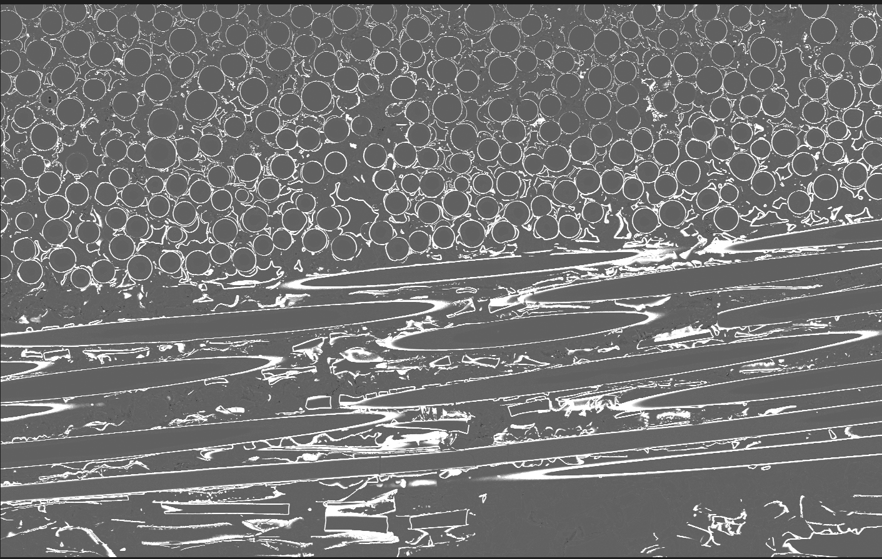
CERAMIC MATRIX COMPOSITES & COATINGS
Ceramic Matrix Composites (CMCs)
CMCs are ceramic fibers embedded in a ceramic matrix. CMCs are low density and can withstand ultra-high temperatures, making them an ideal material for extreme conditions.
CMCs are in high demand from major OEMs for aerospace, heat exchangers, turbine engines, hypersonic-supersonic vehicles, and related applications.
CMC Coatings
Recently developed oxidation resistant coatings for CMCs that extend their useful application to extreme temperatures.
Carbon / Silicon Carbide Ceramic Matrix Composite

Slide 12

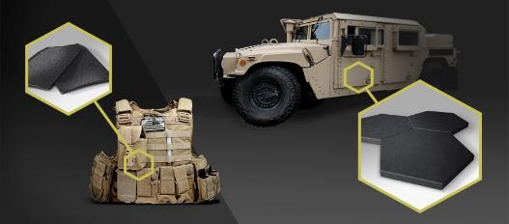
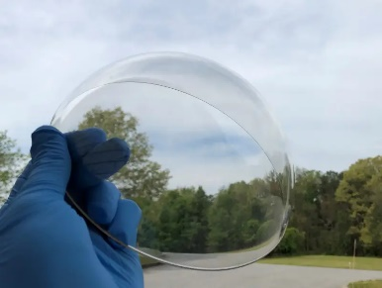



BORON CARBIDE AND SPINEL FOR ARMOR
Global demand is for lightweight, comfortable ceramic armor with superior protection against armor piercing rounds. SINTX’s boron carbide ceramics meet these requirements.
Transparent ceramic ARMOR provides superior ballistic protection at less than half the weight and thickness over traditional glass laminates.
AEROSPACE ARMOR
TRANSPARENT CERAMICS
VEHICLE ARMOR
BODY
ARMOR

Slide 13
CATALYSTS FOR FUTURE GROWTH

Slide 14
AEROSPACE AND DEFENSE
ENERGY
AIRCRAFT ENGINE IGNITORS (Silicon Nitride)
Working with two major companies on commercial jet ignition systems.
MULTI-YEAR CONTRACT WITH THE DEPARTMENT OF ENERGY (3DP - Technical Solutions )
High efficiency heat exchangers developed for high performance military and commercial equipment.
MULTI-YEAR CONTRACT WITH THE DEFENSE ADVANCED RESEARCH PROJECTS AGENCY (Ceramic Matrix Composites)
Combustor for high heat applications.
CMCs FOR NEXT-GENERATION SYSTEMS (Ceramic Matrix Composites)
Accident tolerant fuel containment systems for nuclear reactors.
Receiver tubes for concentrated solar-thermal power systems.
ARMOR (Boron Carbide)
The SLC ARMOR plant has strong interest from potential customers.
AIRCRAFT TURBINE BLADES (3DP - Silica)
Producing resins used to 3D print components used in manufacturing aircraft turbine blades.
THERMAL PROTECTION SYSTEMS FOR AIRCRAFT AND SPACE VEHICLES (Processing Services)
Developing opportunities to provide toll processing services for non-oxide ceramics.

Slide 15
BIOMEDICAL
NEW SOLID SILICON NITRIDE SPINAL IMPLANTS (Silicon Nitride)
Producing implant banks for CTL’s newly launched “Nitro” product line.
3D PRINTED COMPONENTS (3DP - Alumina/Zirconia)
Leveraging SINTX sales team has brought in new opportunities for producing ablation tips, surgical robot components, and other small ceramic medical components.
NIH GRANTS (3DP/Technical Solutions)
Silicon nitride / polymer composites for use in spine, craniomaxillofacial, and trauma plates.
ARTHROPLASTY (Silicon Nitride)
Renewed interest in silicon nitride’s use as a femoral head and acetabular cup.
DENTAL (Silicon Nitride)
Working with dental implant companies to supply novel silicon nitride implants.
NEW OPPORTUNITIES/MARKETS/PRODUCTS
Several new collaborations in developing products for wound care, cancer treatment, and an antipathogenic coating for catheters.
ANTIPATHOGENIC COATINGS (Silicon Nitride)
Completed year two of a successful collaboration with Oxford Performance Materials to develop a composite PEKK and silicon nitride coating for implanted devices.

Slide 16
2024 KEY OBJECTIVES
GROW AEROSPACE, DEFENSE, and 3DP REVENUE
MAINTAIN MATERIALS R&D PROGRAM
DRIVE TOWARDS PROFITABILITY
EXPAND SILICON NITRIDE’S SUCCESSES IN BIOMEDICAL
  Expand customer base in existing and new markets. Increase revenue through continued market development activities.
  Execute on opportunities in composites and coatings.
  Further develop new applications in arthroplasty and wound care.
  Strategically expand externally funded research.
  Continue commercialization of new products from R&D.
  Deploy Operational Excellence activities across the company.
  Expand quality management system to Maryland.

Slide 17
SUMMARY
PORTFOLIO & EXPERTISE
SINTX has a diverse portfolio of advanced ceramics materials, with application across biomedical, aerospace and defense, and energy market sectors. SINTX has unmatched global expertise in the development and application of silicon nitride, based on our premium portfolio offering.
EVOLVING
SINTX has transformed since late 2018 from a specialty materials company into an OEM that can serve diverse markets with various products with a range of quality, value, and economics.
INVEST
Invest as SINTX continues our new trajectory in the wake of two acquisitions which set up the organization for sustained success.

Slide 18
THANK YOU

Slide 19
SUMMARY CAP TABLE AS OF 9/30/23

Slide 20
SINTX’S HISTORY AND TIMELINE
1996
2010
2018
2021
AMEDICA CORPORATION
Surgeon - Scientist
US SPINE ACQUISITION
Added technology
DIVESTED SPINE
to CTL-Medical, Amedica became SINTX Technologies (NASDAQ: SINT)
SINTX ARMOR
B4C LLC assets acquired
2014
IPO
NASDAQ – AMDA
2008
2020
FIRST IMPLANTATION
of Silicon Nitride Spinal Device
2012
DISCOVERY
SINTX’s SN inactivates viruses
2022
DISCOVERY
SINTX’s SN promotes bone fusion, resists bacteria
TA&T ACQUIRED
Expanded into defense, energy, aerospace

Slide 21

MANAGEMENT TEAM
B. Sonny Bal, MD, JD, MBA, Ph.D
Chairman of the Board
Chief Executive Officer
Ryan Bock, Ph.D.
V.P. Research and Development
20 years research in advanced ceramics and medical device research and product development experience
Orthopedic Surgeon and Attorney
Ceramic Scientist and Investigator
CEO since 2014, Board since 2012
David O’Brien, MS
Executive Vice President and Chief Operating Officer
Michael Marcroft, MBA
V.P. Sales and Marketing
20+ years of experience in medical technology business development & marketing
Global corporations and startups
35 years of operations, manufacturing, and engineering experience with medical devices and ceramics

